Slide 1
Management & Entrepreneurship Development
Dept. of Mechanical Engineering,
MCE, Hassan.

Slide 2
Organizing, Staffing, Directing & Controlling
MODULE – 2

Slide 3
CONTENT
Organizing and Staffing: Nature and purpose of organization, principles of organization, types of organization, departmentation committees, centralization v/s decentralization of authority and responsibility, span of control, MBO and MBE (meaning only), nature and importance of staffing, process of selection & recruitment (in brief).
Directing & Controlling: Meaning and nature of directing, leadership styles, motivation theories, communication: meaning and importance, coordination: meaning, importance and techniques. Meaning and steps in controlling, essentials of a sound control system, methods of establishing control.

Slide 4
Objective:
Upon completion of this module, students shall be able to apply the conceptual knowledge of organizing, staffing, directing and controlling while making decisions.

Slide 5
Organisation Definition
An organisation is a social unit or human grouping deliberately structured for the purpose of attaining specific goals.
Amitai Etzioni
The rational coordination of the activities of a number of people for the achievement of some common explicit purpose or goal, through division of labour and function, and through a hierarchy of authority and responsibility.
– Sehein

Slide 6
The process of identifying and grouping of the work to be performed, defining and delegating responsibility and authority and establishing relationships for the purpose of enabling people to work most effectively together in accomplishing their objectives.
– Allen
An organisation is the pattern of ways in which large number of people, too many to have intimate face to face contact with all others, and engaged in a complexity of tasks, relate themselves to each other in the conscious, systematic establishment and accomplishment of mutually agreed purposes.
- Pfiffner & Sherwood

Slide 7
Characteristics of an Organisation
Every organisation has:
a purpose, goal or goals
a clear concept of the major duties or activities required to achieve the purpose
classification of activities into jobs, and
establishment of relationships between these jobs in order to ensure coordination. This is achieved through division of labour and delegation of authority.

Slide 8
Types of Organisations
Four types based on who gets benefit.
Organisations which benefit their owners.
Ex.: Business organisations
Organisations which benefit their members.
Ex.: Unions, cooperatives and clubs
Organisations which benefit their clients.
Ex.: Insurance companies, private schools, etc.
Organisations which benefit the whole society.
Ex.: Governmental departments, the armed services and the police.

Slide 9
Process of Organising
Organising means designing the organisation structure.
In performing the organising function, the manager differentiates and integrates the activities of his organisation.
Organising consists of a seven-step procedure
Consideration of objectives
The first step in organising is to know the objectives of the enterprise.
Objectives determine the various activities which need to be performed.

Slide 10
Deciding organisational boundaries
Making manufacture-versus-buy choices for different goods and services and choices about strategic alliances with other firms.
Also choices have to be made about the extent to which the different parts of the organisation interact directly with the outside environment.
Grouping of activities into departments
All closely related and similar activities are grouped into departments and sections.
Ex.: Activities of a manufacturing company may be grouped into production, marketing, financing and personnel departments.

Slide 11
Deciding which departments will be key departments
Key departments are those which are rendering key activities, i.e., activities essential for the fulfilment of goals.
The key departments should be placed directly under higher management.
Determining levels at which various types of decisions are to be made
Each firm must decide, how much decentralisation of authority and responsibility it wants to have.
Extreme decentralisation may lead to loss of control and effective coordination.
Extreme centralisation, may lead to wrong decisions at wrong times and complete breakdown of the morale of employees.

Slide 12
Determining the span of management
To determine the number of subordinates who should report directly to each executive.
Setting up a coordination mechanism
A direct consequence of departmentalisation is the need to coordinate the independent activities of the members of the organisations.
As individuals and departments carry out their specialised activities, the overall goals of the organisation may become submerged or conflicts among organisation members may develop.

Slide 13
Principles of Organising
Objectives
The objectives of the enterprise influence the organisation structure and hence the objectives of the enterprise should first be clearly defined.
Specialisation
The activities of the enterprise should be grouped according to functions and assigned to persons according to their specialisation.
Span of Control
As there is a limit to the number of persons that can be supervised effectively by one boss, the span of control should be as far as possible, the minimum.

Slide 14
Management by Exception(MBE)
As the executives at the higher levels have limited time, only exceptionally complex problems should be referred to them and routine matters should be dealt with by the subordinates at lower levels. This will enable the executives at higher levels to devote time to more important and crucial issues.
Scalar principle or Chain of command
The line of authority from the chief executive at the top to the first-line supervisor at the bottom must be clearly defined.
Unity of Command
Each subordinate should have only one superior whose command he has to obey.

Slide 15
Delegation
The authority delegated should be equal to responsibility, i.e., each manager should have enough authority to accomplish the task assigned to him.
Responsibility
The superior should be held responsible for the acts of his subordinates.
Authority
The authority is the tool by which a manager is able to accomplish the desired objective.

Slide 16
Efficiency
The organisation structure should enable the enterprise to function efficiently and accomplish its objectives with the lowest possible cost.
Simplicity
The organisation structure should be as simple as possible and the organisation levels should, as far as possible, be minimum.
Flexibility
The organisation should be adaptable to changing circumstances.

Slide 17
Balance
There should be a reasonable balance in the size of various departments, between centralisation and decentralisation, between the principle of span of control and the short chain of command, and among all types of factors such as human, technical and financial.
Unity of Direction
There should be one objective and one plan for a group of activities having the same objective.

Slide 18
Personal Ability
As people constitute an organisation, there is need for proper selection, placement and training of staff.
Acceptability
The structure of the organisation should be acceptable to the people who constitute it.

Slide 19
Span of Management or Span of Control
It indicates the number of subordinates who report directly to a manager.
Determination of an appropriate span of management is important.
Span of management affects the efficient utilisation of managers and the effective performance of their subordinates.
Too wide a span may mean that managers are overstraining themselves and that their subordinates are receiving too little guidance or control.
Too narrow a span of management may mean that managers are underutilised and that their subordinates are overcontrolled.

Slide 20
There is a relationship between span of management and organisation structure.
A narrow span of management results in a tall organisation with many levels of supervision between top management and the lowest organisational levels. This creates more communication and cost problems.

Slide 21
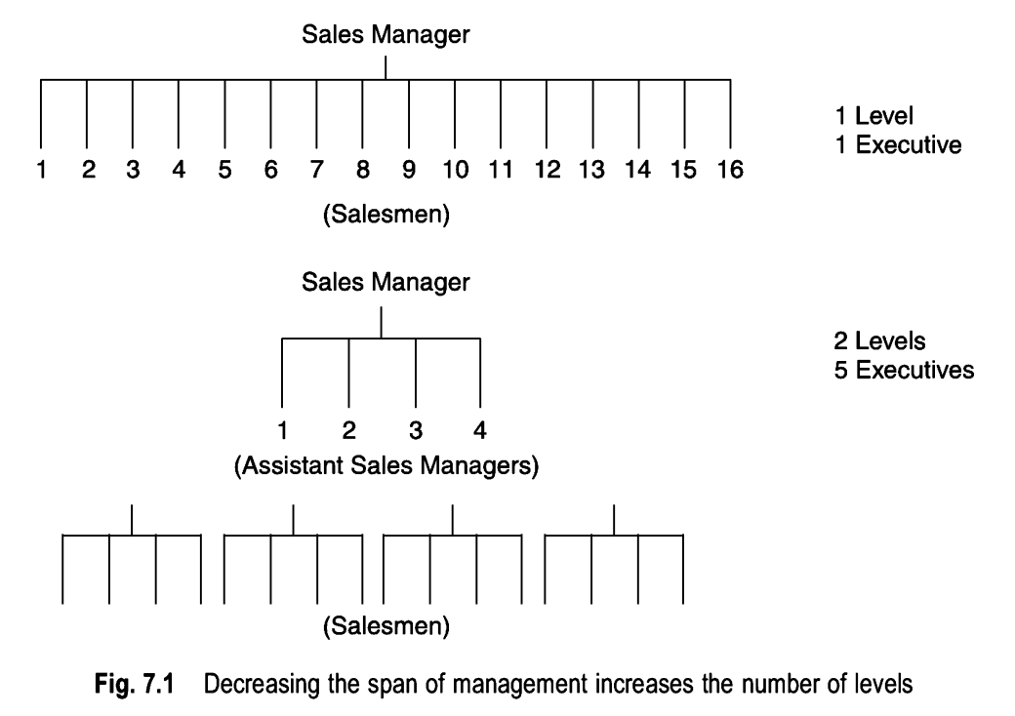

Slide 22
Factors Governing the Span of Management (Contingency Approach)
Ability of the Manager
In an organisation, the span of management should be based on a manager of average ability.
Ability of the Employees
If the employees are competent and possess the necessary skill and motivation to perform the task assigned, less attention from the manager is required and a larger span of management can be used.

Slide 23
Type of Work
If employees are doing similar jobs, the span of management can be larger. If their jobs are quite different, a small span may be necessary.
Well-defined Authority and Responsibility
This helps a superior to manage a large number of subordinates.
Geographic Location
An office manager who has 25 employees, all located in one room may be able to supervise them very well. But a sales manager who has 25 sales people located in 25 different districts would find direct supervision impossible.

Slide 24
Sophisticated Information and Control System
This helps the superior to control a large number of subordinates.
Level of Management
Span of management also varies with each level in the organisation.
Economic Considerations
An economic balance has to be arrived at between cost savings that result from the largest possible span and the added costs because of small span.

Slide 25
Departmentalisation
The horizontal differentiation of tasks or activities into discrete segments is called departmentalisation.
Departmentalisation is one important step of building an organisation.
The aim is to take advantage of the division of labour and specialisation up to a certain limit.
Types of deparmentalisation:
Process deparmentalisation: Business or Organisational Functions, Technology
Purpose departmentalization: Products, Customers, Regions, Territory or Location

Slide 26
Committees
A committee is a group of people who have been formally assigned some task or some problem for their decision and/or implementation.
Committees are often set up where new kinds of work and/or unfamiliar problems seem to involve decisions, responsibilities and powers beyond the capabilities of any one man or department.

Slide 27
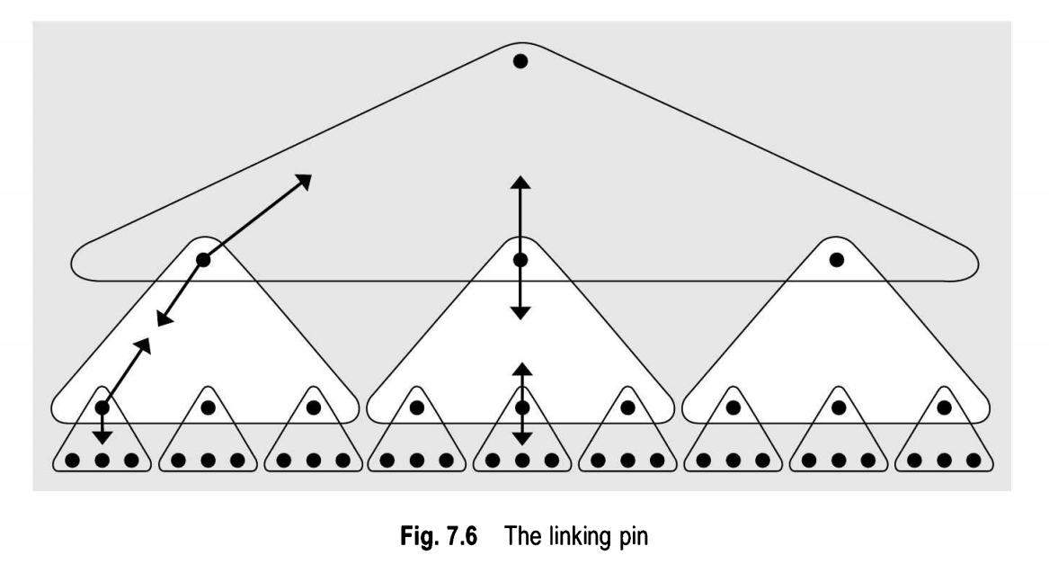

Slide 28
Advisory committees have only a recommendatory role and cannot enforce implementation of their advice or recommendation.
Executive committees not only take decisions but also enforce decisions and thus perform a double role of taking a decision and ordering its execution. The Board of Directors of a company is an example of an executive committee.

Slide 29
Committees may also be classified as standing committees and ad hoc task forces.
Standing or permanent committees are formed to deal with recurrent organisational problems.
Ex.: Finance committee in a company, loan approval committee in a bank, admission committee in a college.
Ad hoc task forces, have a short duration. They are dissolved after the task is over, or the problem is solved. The members are chosen for their skills and experience.

Slide 30


Advantages
Committees consist of all departmental heads as members, people get an opportunity to better understand each other’s problems and to move towards organizational goals.
Committees provide a forum for the pooling of knowledge and experience of many persons of different skills, ages and backgrounds.

Slide 31
Committees provide an opportunity to many persons to participate in the decision-making process.
Committees are excellent means of transmitting information and ideas, both upward and downward.
By exposing members to different viewpoints, committees contribute indirectly to their training and development.
Committees are impersonal in action and hence their decisions are generally unbiased and are based on facts. There is no fear of a single individual taking a biased decision.

Slide 32
Weaknesses
It takes longer to get action from a committee than from an individual manager.
In case a wrong decision is taken by a committee, no member can be individually held responsible. This encourages irresponsibility among the members.
A huge amount is spent in convening meetings and giving allowances to the members. Hence, committees are an expensive form of administration.
Decisions are generally arrived at on the basis of some compromise among the members. Hence they are not the best decisions.
As committees consist of a large number of persons, it is difficult to maintain secrecy regarding the decisions taken at the committee meetings.

Slide 33
Suggestions for Making Committees Effective
The number of members on a committee should not be very large.
A committee’s authority should be carefully spelled out, and its activities are correctly chosen and closely defined.
The members of a committee should enjoy equal formal status so that they interact with each other freely.
The members should give precedence to organisational interests over departmental interests and should be prepared in advance on issues to be discussed in the meeting.

Slide 34
Information should be shared prior to the meeting so that the focus of the meeting can be on problem solving.
The chairman of the committee should plan and conduct the meeting with firmness and fairness.
The work of the committee should be periodically reviewed to determine if it is working effectively, in terms of the purpose for which it was established, and whether that purpose is still valid.

Slide 35
Authority
It is the legitimate right of a superior to command and compel his subordinates to perform a certain act.
It can be delegated to a subordinate by his superior.
It is mostly well-defined and finite.
It is what exists in the eye of law.

Slide 36
Responsibility
Authority is the right of a superior to issue commands, responsibility is the obligation of a subordinate to obey those commands.
Thus, when a superior assigns some work to a subordinate, it becomes his responsibility to perform it.
Responsibility cannot be delegated or transferred.

Slide 37
Responsibility is divided into two parts at the time of delegation:
Operating responsibility: The subordinate assumes only the operating responsibility for the task
Ultimate responsibility: The superior retains ultimate responsibility for getting the job done.
If the subordinate fails to perform the job (operating responsibility), the superior is held responsible for this failure (ultimate responsibility).

Slide 38
Authority Should Equal Responsibility
The subordinate must have been delegated enough authority to undertake all the duties which have been assigned to him and for which he has accepted responsibility.
A subordinate manager cannot be expected to accept responsibility for activities for which he has no authority.
The subordinate should not have more authority than responsibility or vice versa.
Inequality between the two produces undesirable results.
If authority exceeds responsibility, a misuse of authority can easily result.
On the other hand, if responsibility exceeds authority, the subordinate may find himself in a very frustrating situation.

Slide 39
Centralisation and Decentralisation
In a centralised set-up, the decision-making authority is concentrated in a few hands at the top and in a decentralised set-up, it is delegated to the levels where the work is to be performed.

Slide 40
Advantages of Decentralisation
Decentralisation reduces problem of communication and red tape.
It permits quicker and better decision-making.
Decentralisation recognises and actually capitalizes on the importance of the human element. Under decentralisation, employees are able to exercise more autonomy
It leads to a competitive climate within the organization.
Decentralisation ensures the development of employees.
Decentralisation facilitates diversification of products, activities and markets.

Slide 41
Advantages of Centralisation
Coordination of activities of subordinates is better achieved.
There is no duplication of efforts or resources.
Decisions take into account the interest of the entire organisation.
Strong central leadership develops which may be required in crisis.

Slide 42
Staffing
It is important to have a good organisation structure, but it is even more important to fill the jobs with the right people.
All managers have a responsibility for staffing.

Slide 43
Staffing includes several sub-functions:
Recruitment, or getting applicants for the jobs as they open up.
Selection of the best qualified from those who seek the jobs.
Training those who need further instructions to perform their work effectively or to qualify for promotions.
Performance appraisal, since it serves as the basis for job change or promotion.
Administration of compensation plans, since it is an important factor in both getting and holding qualified people.

Slide 44
Importance and Need for Proper Staffing
It helps in discovering talented and competent workers and developing them to move up the corporate ladder.
It ensures greater production by putting the right man in the right job.
It helps to avoid a sudden disruption of an enterprise’s production run by indicating shortages of personnel, if any, in advance.
It helps to prevent under-utilisation of personnel through overmanning and the resultant high labour cost and low profit margins.

Slide 45
Recruitment
Once the requirement of manpower is known, the process of recruitment starts.
The management should have a proper plan of recruitment regarding the quantity and quality of personnel required and the time when it is needed.

Slide 46
Definition
The process of identifying the sources for prospective candidates and to stimulate them to apply for the jobs.
or
Recruitment is the generating of applications or applicants for specific positions.
or
It is the process of attracting potential employees to the company.

Slide 47
Sources of Recruitment
The sources of recruitment can be broadly classified into two categories: internal and external
Internal sources refer to the present working force of a company.
Vacancies other than at the lowest level may be filled by selecting individuals from amongst the existing employees of the company.

Slide 48
External sources are:
Re-employing former employees
Friends and relatives of present employees
Applicants at the gate
College and technical institutions
Employment exchanges
Advertising the vacancy
Labour unions

Slide 49
Evaluation of Alternative Sources
Following are some of the measures which can be used to assess how good or how poor various sources have proved to be:
Time lag between requisition and placement
Recruitment ratio, that is, the number of persons actually hired, per 100 applicants
Employee attitude studies to discover the reactions of present employees to both external and internal recruiting
Correlation between different sources of recruitment and factors of success on the job
Data on turnover, grievances, and disciplinary action, tabulated according to different sources of recruitment to throw light on the relative merits of each source.
Gross cost per hire. This is arrived at by dividing the total cost of recruitment by the number of individuals hired.

Slide 50
Advantages of Internal Recruitment
A sense of security develops among the employees
Employees remain loyal to the organization
People recruited from within the organisation do not need induction training
Employees in the lower ranks are encouraged to look forward to rising to higher position in the concern
Labour turnover is reduced
People are motivated to become efficient
Valuable contacts with major suppliers and customers remain intact
A better employer-employee relationship is established

Slide 51
Disadvantages of Internal Recruitment
This method limits the choice of selection to the few candidates available within the enterprise.
It may encourage favouritism and nepotism.
If a concern is extending its activities into new lines, internal candidates may prove unsuitable for new positions. This may involve extra expenditure in imparting necessary training to them.

Slide 52
Advantages of External Recruitment
Old habits are replaced by new ones and the concern becomes more dynamic.
The field of choice becomes very wide. Hence there is the possibility of selecting people with rich and varied experience.

Slide 53
Disadvantages of External Recruitment
If a concern makes recruitment from external sources, its employees generally feel frustrated and their morale is adversely affected.
The present employees may lose their sense of security and become disloyal to the employer.
There is a greater turnover of labour.
There is deterioration in the employer-employee relationship, resulting in industrial unrest, strikes and lock-outs.

Slide 54
Selection
During selection manager compares qualifications of candidates with the requirements of a job and eliminates all those who do not stand up to this comparison.
Steps in the Selection Procedure
Though there is no standard procedure adopted by all organisations, the following is an example of a popular sequence of steps:
Application blank
Initial interview of the candidate
Employment tests
Checking references
Physical or medical examination
Final interview

